Slide 1
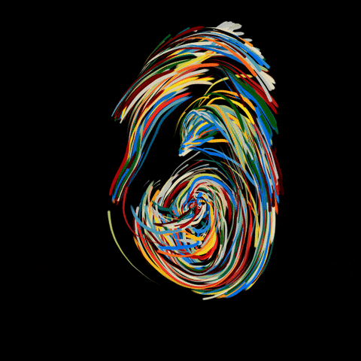
The Teal Canvas

Slide 2
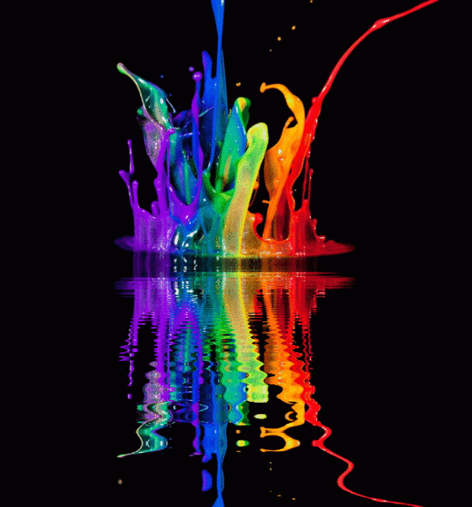
About
The Teal Canvas team emphasizes the visual medium of 2D images, digital imagery and photographic art and the opportunity for every individual to participate in the art gallery experience of displaying and selling their work in a unique way.

Slide 3
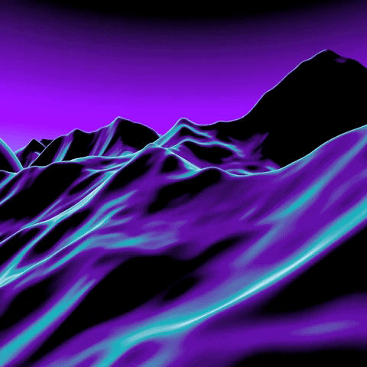
The Teal Canvas Creators
Alex Engelmann
Jim Tatarakis
Johanna Casimir-Mahoney
Liam Hartigan

Slide 4
The Technology
HTML
CSS
Mongo-Seeding
Mongoose
React
React-iframe
Heroku
Google Forms
Express
Heroku
Google Forms
.ENV

Slide 5
Future Development
List
List
List
List

Slide 6
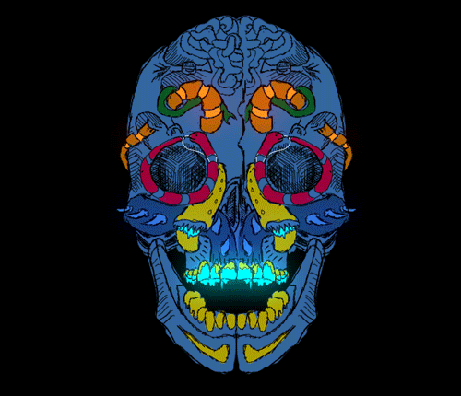
DEMO

